Slide 1
Data Structures
Graphs

Slide 2
Graphs
Definition = a set of nodes (vertices) with edges (links) between them.
G = (V, E) - graph
V = set of vertices ⎜V ⎜= n
E = set of edges ⎜E ⎜= m
Binary relation on V
Subset of V x V ={(u,v): u ∈V, v ∈V}
1
2
3
4

Slide 3
Example:
V = {1, 2, 3, 4}
E = {(1, 2), (3, 1), (2, 3), (2, 4), (3, 4), (4, 3)}
1
2
3
4

Slide 4
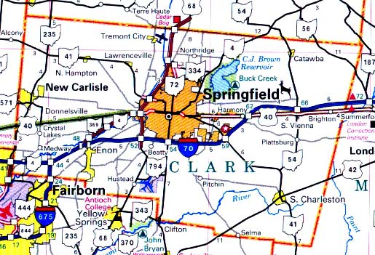
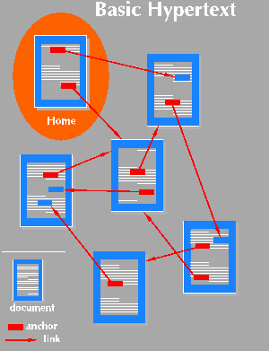

Graph Applications
Applications that involve not only a set of items, but also the connections between them
Maps
Schedules
Computer networks
Hypertext
Circuits

Slide 5
Types of Graph
Directed Graph
Directed graph is also called digraph is a collection of nodes connected by edges, where the edges have a direction linked with them.
Undirected Graph
An undirected graph is a type of graph, in which a set of vertices or nodes are connected, and all the edges are bidirectional.

Slide 6
Directed vs Undirected graphs

Slide 7
Complete graph
A graph with an edge between each pair of vertices
Subgraph
A graph (V’, E’) such that V’⊆V and E’⊆E
Path from v to w
A sequence of vertices <v₀, v₁, …, v_{k}> such that v₀=v and v_{k}=w
Length of a path
Number of edges in the path
1
2
path from v₁ to v₄
<v₁, v₂, v₄>
3
4

Slide 8
1
2
w is reachable from v
If there is a path from v to w
Simple path
All the vertices in the path are distinct
Cycles
A path <v₀, v₁, …, v_{k}> forms a cycle if v₀=v_{k} and k≥2
Acyclic graph
A graph without any cycles
3
4
cycle from v₁ to v₁
<v₁, v₂, v₃,v₁>

Slide 9
Connected and Strongly Connected graph

Slide 10
Adjacent node If e(u,v) represent an edge between u and v vertices then both u and v are called adjacent to each other. That means, u is adjacent to v and v is adjacent to u.
Degree of a vertex is the number of edges connected to a vertex
Indegree In a directed graph, indegree of a vertex is the number of edges ending at the vertex.
Outdegree In a directed graph, outdegree of a vertex is the number of edges beginning at the vertex.
Loop It is an edge whose endpoint is same.

Slide 11
Graph Representation
Adjacency list representation of G = (V, E)
An array of ⎜V ⎜lists, one for each vertex in V
Each list Adj[u] contains all the vertices v that are adjacent to u (i.e., there is an edge from u to v)
Can be used for both directed and undirected graphs
1
2
5 | /
1
2
2
1
5
3
4 | /
3
3
2
4
5
4
4
2
5
3 | /
5
4
1
2
Undirected graph

Slide 12
Properties of Adjacency-List Representation
Sum of “lengths” of all adjacency lists
Directed graph:
edge (u, v) appears only once (i.e., in the list of u)
Undirected graph:
edge (u, v) appears twice (i.e., in the lists of both u and v)
1
2
⎜E ⎜
3
4
Directed graph
2 ⎜E ⎜
1
2
3
5
4
Undirected graph

Slide 13
Graph Representation
Adjacency matrix representation of G = (V, E)
Assume vertices are numbered 1, 2, … ⎜V ⎜
The representation consists of a matrix A _{⎜V ⎜x ⎜V ⎜}:
a_{ij} = 1 if (i, j) ∈ E
0 otherwise
1
2
3
4
5
For undirected graphs, matrix A is symmetric:
a_{ij} = a_{ji}
A = A^{T}
1
2
1
0
1
0
0
1
3
2
1
0
1
1
1
5
4
3
0
1
0
1
0
4
0
1
1
0
1
Undirected graph
5
1
1
0
1
0

Slide 14
Properties of Adjacency Matrix Representation
Memory required
Θ(V²), independent on the number of edges in G
Preferred when
The graph is dense: ⎜E ⎜is close to ⎜V ⎜²
We need to quickly determine if there is
an edge between two vertices
Time to determine if (u, v) ∈ E:
Θ(1)
Disadvantage
No quick way to determine the vertices
adjacent to another vertex
Time to list all vertices adjacent to u:
Θ(V)
1
2
3
5
4
Undirected graph
1
2
3
4
Directed graph

Slide 15
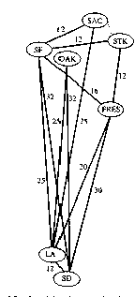
Weighted Graphs
Graphs for which each edge has an associated weight w(u, v)
w: E → R, weight function
Storing the weights of a graph
Adjacency list:
Store w(u,v) along with vertex v in u’s adjacency list
Adjacency matrix:
Store w(u, v) at location (u, v) in the matrix

Slide 16
Weighted Graphs

Slide 17
GRAPH TRAVERSAL
One of the common tasks associated with graphs is to traverse or visit the graph nodes and edges in a systematic manner. There are two methods of traversing a graph:
Breadth First Search (BFS)
Depth First Search (DFS)

Slide 18
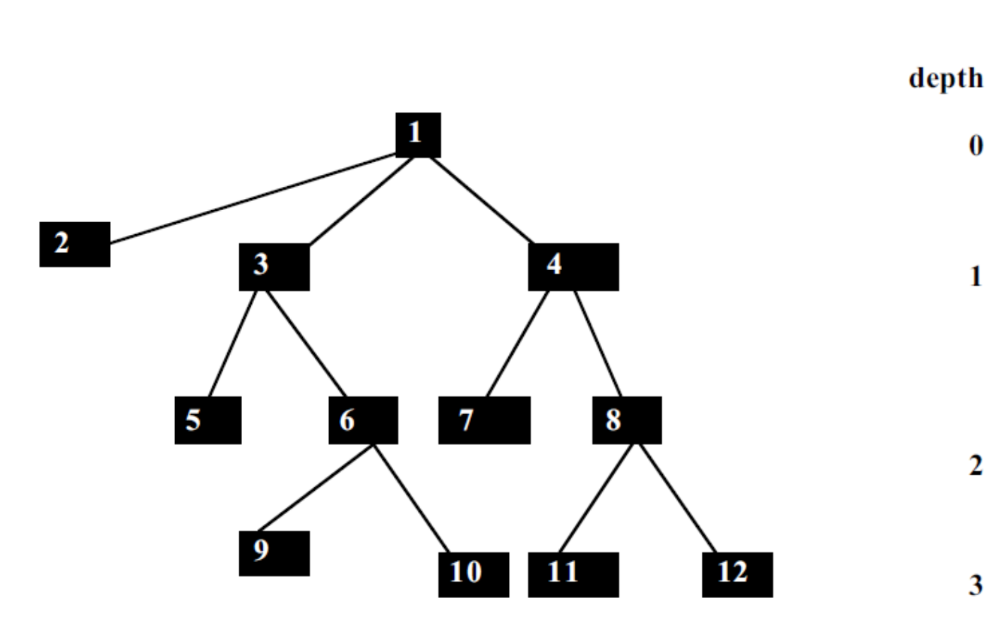

Slide 19
Procedure Breadth-first-search
Begin
i) Place the starting node in a queue;
ii) Repeat
Delete queue to get the front element;
If the front element of the queue = goal,
return success and stop;
Else do
Begin
insert the children of the front element,
if exist, in any order at the rear end of the queue;
End
Until the queue is empty;
End.

Slide 21
Procedure Depth first search
Begin
1. Push the starting node at the stack, pointed to by the stack-top;
2. While stack is not empty do
Begin
Pop stack to get stack-top element;
If stack-top element = goal, return success and stop
Else push the children of the stack-top element in any order
into the stack;
End
End.

